Slide 1
EMTH403
Mathematical Foundation for Computer Science

Slide 2
Lecture Outcomes
understand what are Boolean Functions
understand what are Boolean Expressions
understand how to write Boolean Expressions into a logical equivalence.

Slide 3
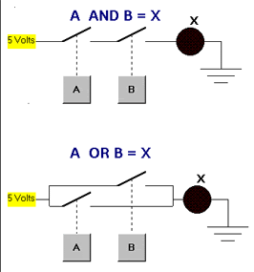
Boolean Algebra
The circuits in computers and other electronic devices have inputs, each of which is either a 0 or a 1 and produce outputs that are also 0s and 1s.
Circuits can be constructed using any
basic element that has two different states.
Such elements include switches that can be in either the on or the off position and optical devices that can be either lit or unlit.

Slide 4
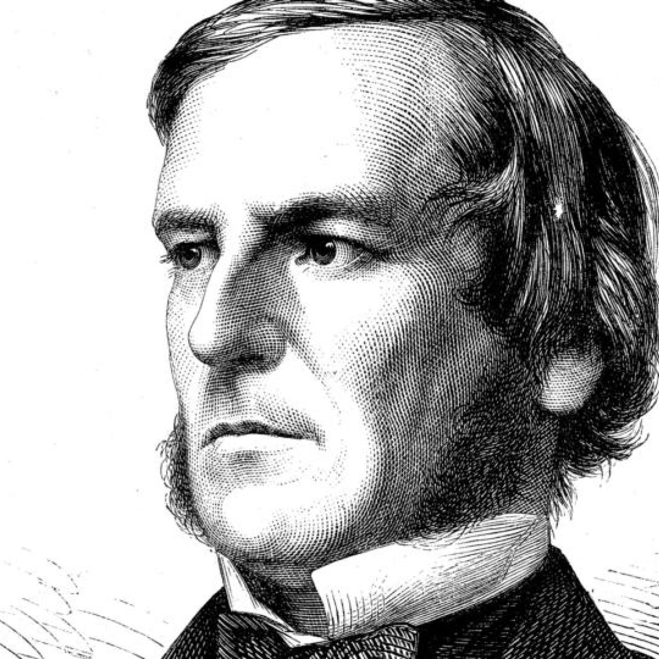
Boolean Algebra
In 1938 Claude Shannon showed how the
basic rules of logic, first given by
George Boole in 1854 in his
The Laws of Thought, could be used
to design circuits.
These rules form the basis for Boolean algebra.
Here we discuss the basic properties of Boolean algebra.

Slide 5
Boolean Algebra
The operation of a circuit is defined by a Boolean function that specifies the value of an output for each set of inputs.
The first step in constructing a circuit is to represent its Boolean function by an expression built up using the basic operations of Boolean algebra.

Slide 6
Boolean Functions - Introduction
Boolean algebra provides the operations and the rules for working with the set {0, 1}.
Electronic and optical switches can be studied using this set and the rules of Boolean algebra.
The three operations in Boolean algebra that will be used most are complementation, the Boolean sum, and the Boolean product.

Slide 7
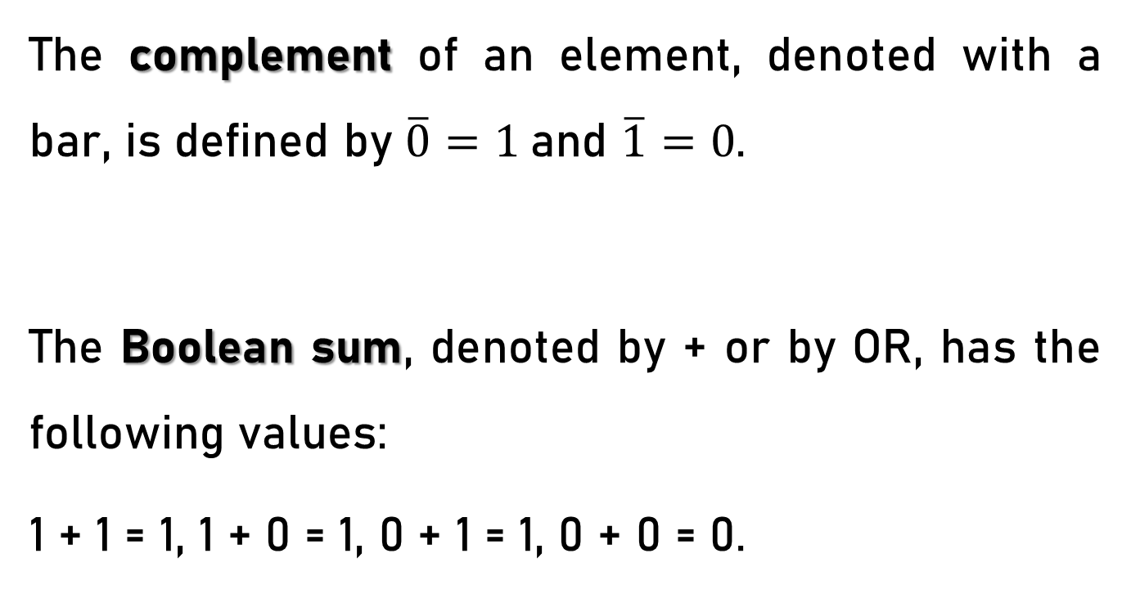
Boolean Functions - Introduction
The complement of an element, denoted with a bar, is defined by $\overline{0}=1$and $\overline{1}=0$.
The Boolean sum, denoted by + or by OR, has the following values:
1 + 1 = 1, 1 + 0 = 1, 0 + 1 = 1, 0 + 0 = 0.

Slide 8
Boolean Functions - Introduction
The Boolean product, denoted by · or by AND, has the following values:
1 · 1 = 1, 1 · 0 = 0, 0 · 1 = 0, 0 · 0 = 0.

Slide 9
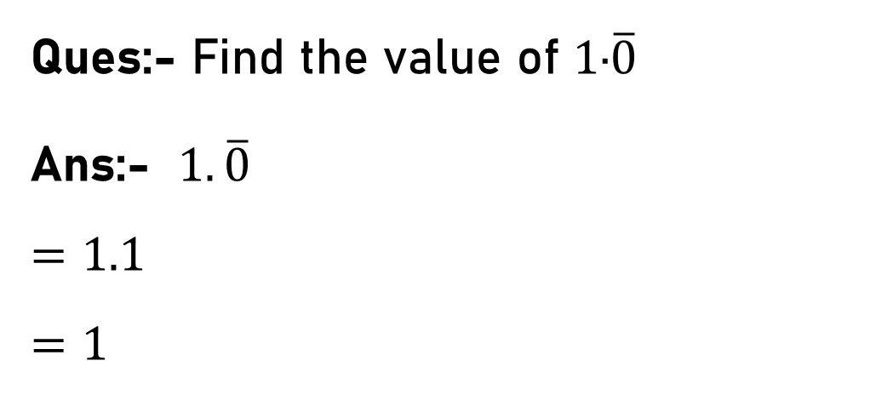
Boolean Functions – Introduction Example 1
Ques:- Find the value of $1\text{·}\overline{0}$
Ans:- $1.\overline{0}$
$$=1.1$$
$$=1$$

Slide 10
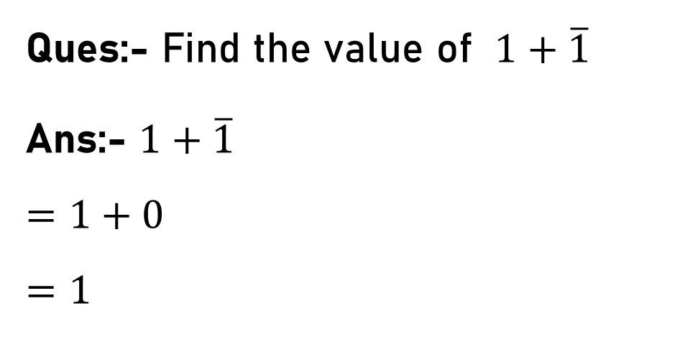
Boolean Functions – Introduction Example 2
Ques:- Find the value of $1+\overline{1}$
Ans:- $1+\overline{1}$
$$=1+0$$
$$=1$$

Slide 11

Boolean Functions – Introduction Example 3
Ques:- Find the value of $\text{0}\text{·}\overline{0}$
Sol:- $\text{0}\text{·}\overline{0}$
$$\text{=}\text{0}\text{·}\text{1}$$
$$\text{=}\text{0}$$

Slide 12
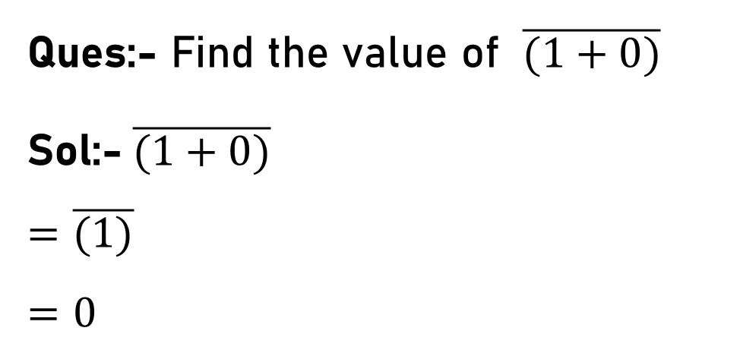
Boolean Functions – Introduction Example 4
Ques:- Find the value of $\overline{(1+0)}$
Sol:-$\overline{(1+0)}$
$$=\overline{(1)}$$
$$=0$$

Slide 13

Boolean Functions – Introduction Example 5
Ques:- Find the value of 1 · 0 + $(\overline{\text{0 + 1}}$).
Sol:- 1 · 0 + $(\overline{\text{0 + 1}}$)
= 0 + $(\overline{\text{1}}$)
= 0 + 0
= 0.

Slide 14
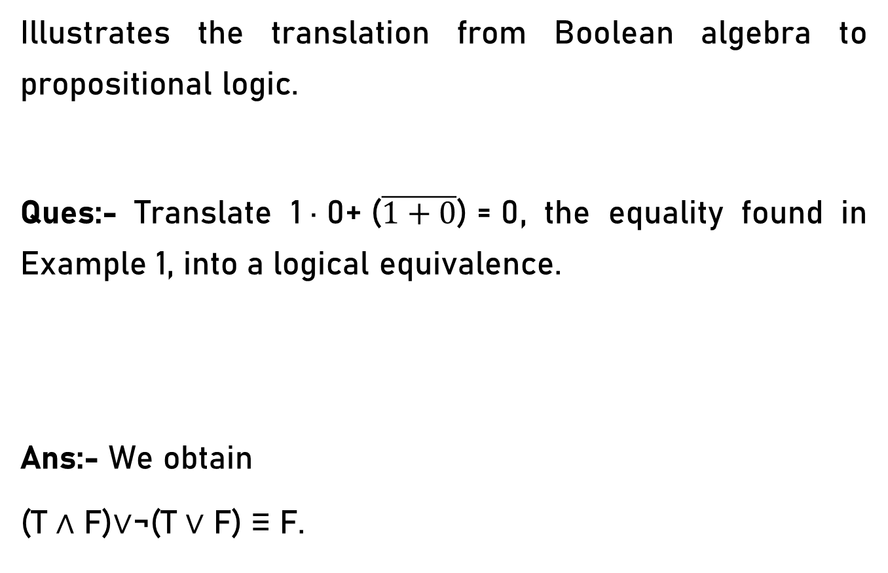
Boolean Functions – Introduction Example 1
Illustrates the translation from Boolean algebra to propositional logic.
Ques:- Translate $\text{1 · 0+ (}\overline{1+0}\text{) = 0}$, the equality found in Example 1, into a logical equivalence.
Ans:- We obtain
(T ∧ F)∨¬(T ∨ F) ≡ F.

Slide 15
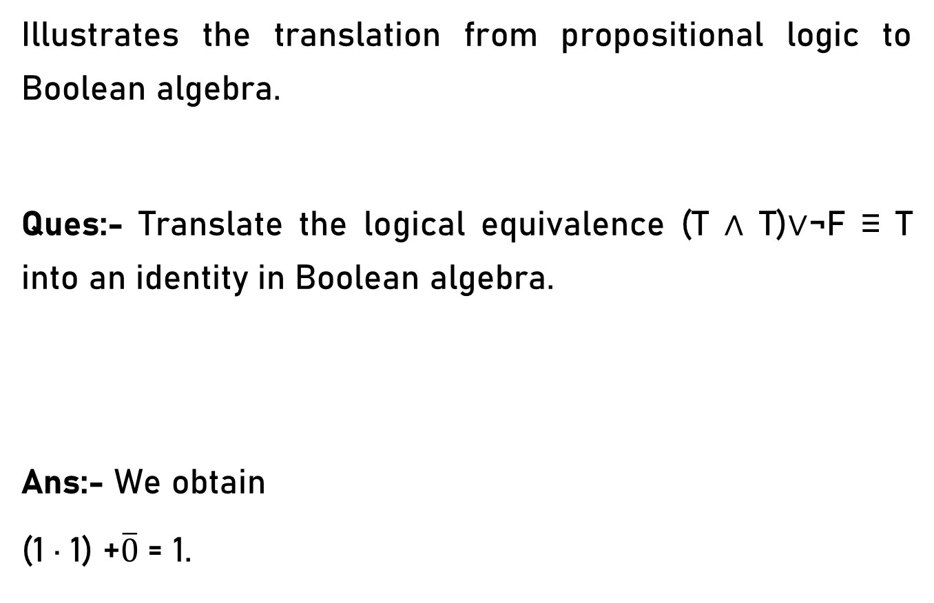
Boolean Functions – Introduction – Example 1
Illustrates the translation from propositional logic to Boolean algebra.
Ques:- Translate the logical equivalence (T ∧ T)∨¬F ≡ T into an identity in Boolean algebra.
Ans:- We obtain
(1 · 1) +$\overline{0}$= 1.

Slide 16
Boolean Functions
Let B = {0, 1}. Then B^{n} = {(x₁, x₂, . . . , x_{n}) | x_{i} ∈ B for
{1 ≤ i ≤ n} is the set of all possible n-tuples of 0s and 1s.
The variable x is called a Boolean variable if it assumes values only from B, that is, if its only possible values are 0 and 1.
A function from B^{n} to B is called a Boolean function of degree n.

Slide 17
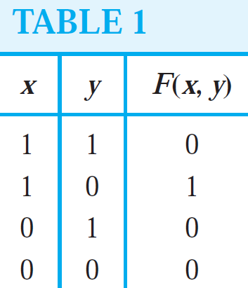
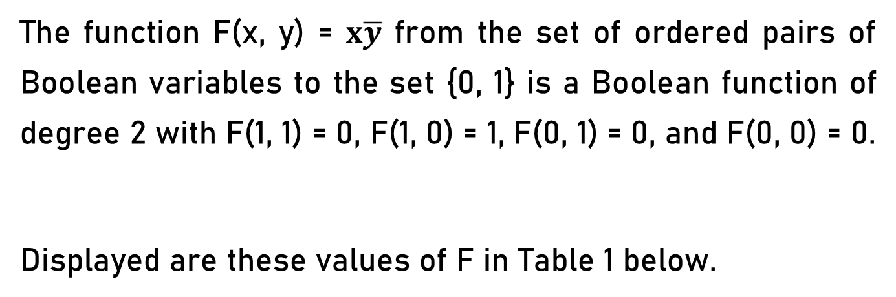
Boolean Functions
The function F(x, y) = $x\overline{y}$ from the set of ordered pairs of Boolean variables to the set {0, 1} is a Boolean function of degree 2 with F(1, 1) = 0, F(1, 0) = 1, F(0, 1) = 0, and F(0, 0) = 0.
Displayed are these values of F in Table 1 below.

Slide 18
Boolean Expressions
Boolean functions can be represented using expressions made up from variables and Boolean operations.
The Boolean expressions in the variables x₁, x₂, . . . , x_{n} are defined recursively as 0, 1, x₁, x₂, . . . , x_{n} are Boolean expressions;
Each Boolean expression represents a Boolean function.

Slide 19
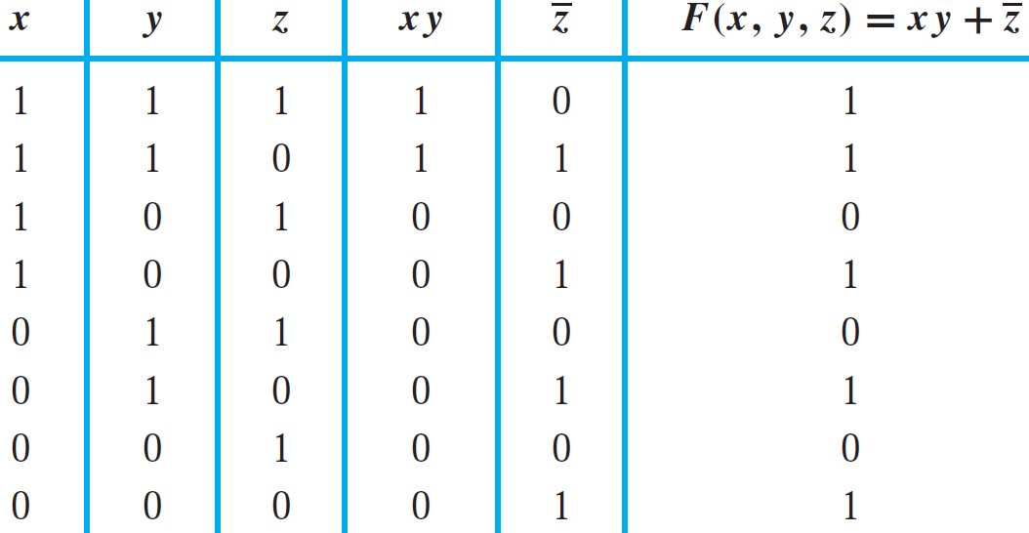
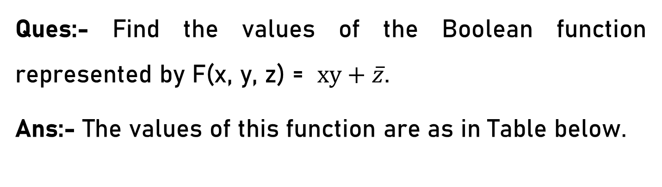
Boolean Expressions
Ques:- Find the values of the Boolean function represented by F(x, y, z) = $xy+\overline{z}$.
Ans:- The values of this function are as in Table below.

Slide 20
Boolean Expressions
Show that the distributive law x(y + z) = xy + xz is valid.
The verification of this identity is shown in Table below. The identity holds because the last two columns of the table agree.

Slide 21
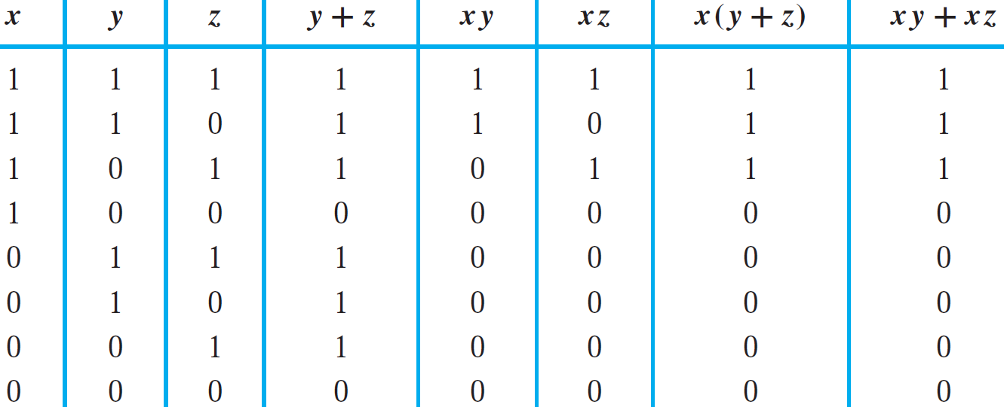
Boolean Expressions
Show that the distributive law x(y + z) = xy + xz is valid.

Slide 22
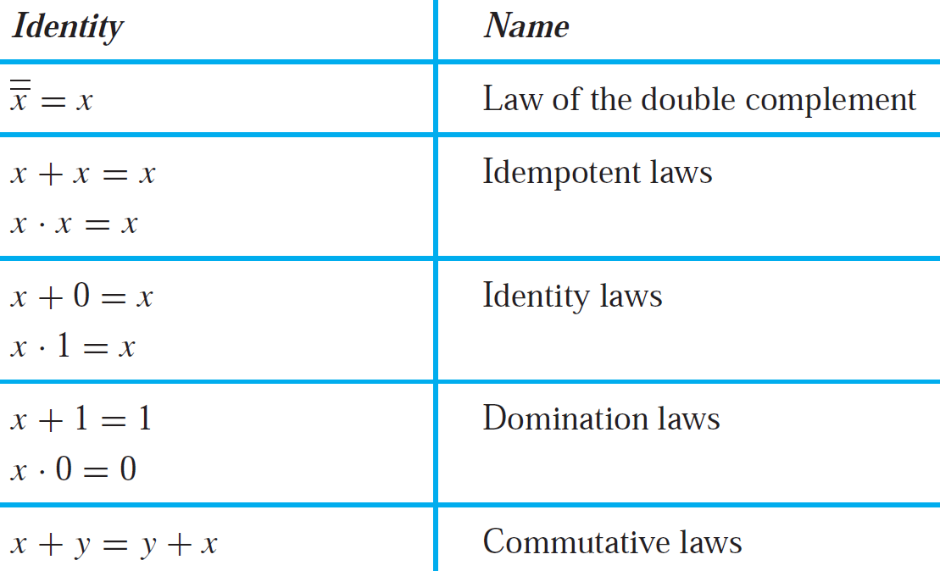
Boolean Expressions
Similarly, we can find the validity of the following identities.

Slide 23
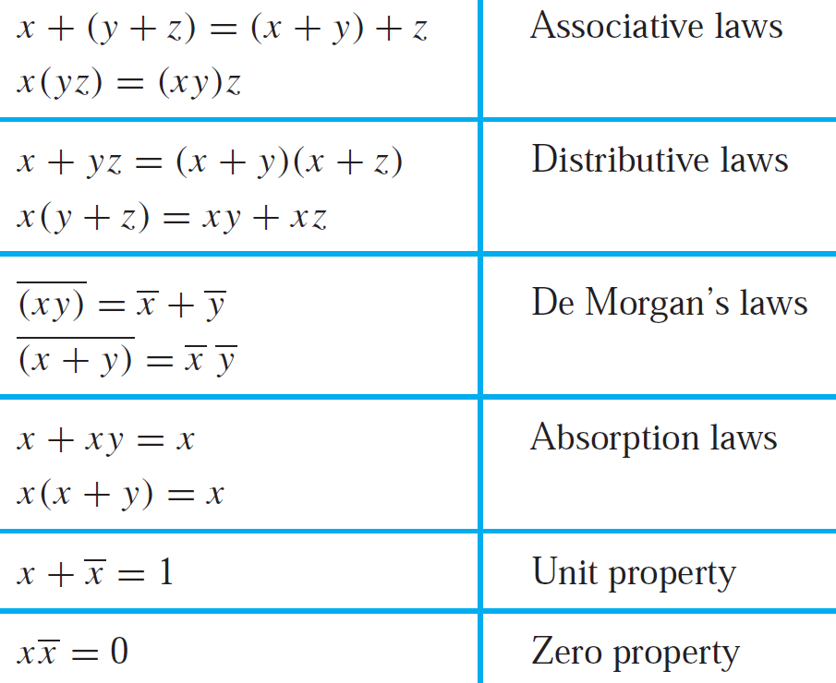
Boolean Expressions
Similarly, we can find the validity of the following identities.

Slide 24
Boolean Expressions – Example 1
Translate the distributive law x + yz = (x + y)(x + z) in into a logical equivalence.
Here we will change the Boolean variables x, y, and z into the propositional variables p, q, and r.
Next, we change each Boolean sum into a disjunction and each Boolean product into a conjunction.
p ∨ (q ∧ r) ≡ (p ∨ q) ∧ (p ∨ r).

Slide 25
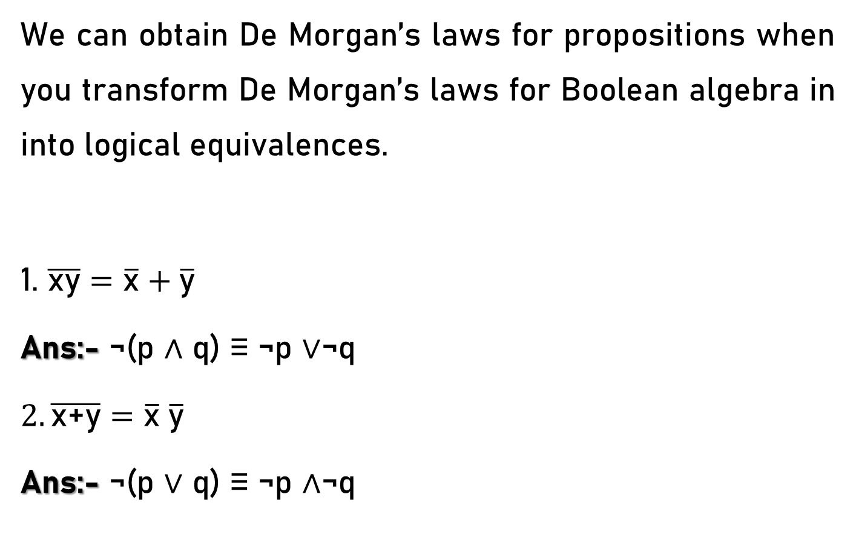
Boolean Expressions – Example 2
We can obtain De Morgan’s laws for propositions when you transform De Morgan’s laws for Boolean algebra in into logical equivalences.
1. $\overline{\text{xy}}=\overline{\text{x}}+\overline{\text{y}}$
Ans:- ¬(p ∧ q) ≡ ¬p ∨¬q
$2. \overline{\text{x}\text{+}\text{y}}=\overline{\text{x}} \overline{\text{y}}$
Ans:- ¬(p ∨ q) ≡ ¬p ∧¬q

